Slide 1







Human resources slide 1
Our Team
Success Transformation
from Text Architecture
Nikeeta Brijwasi
Rudraksh Syal
Client Name:
CRAIGSLIST
6th December 2018
Amratansh Sharma
Prince Kumar
Ananth Nath

Slide 2
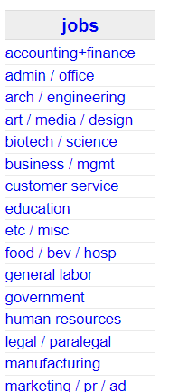
Human resources slide 2
Craigslist Background
American classified advertisement website focusing on different domains
We consider jobs subsection as our area of interest
Specifically we aim to improve the job listings in business/management domain
The Information present in job listings is vague and unstructured

Slide 3



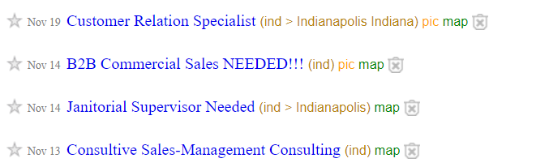

Human resources slide 6
Problem Accounted
Lack of understanding with the current format of presentation.
Titles do not convey the accurate information.
Lack of information on the search page.
Large number of unstructured job postings.
Spam job postings leading to irrelevant search results.
Craigslist
Indeed

Slide 4
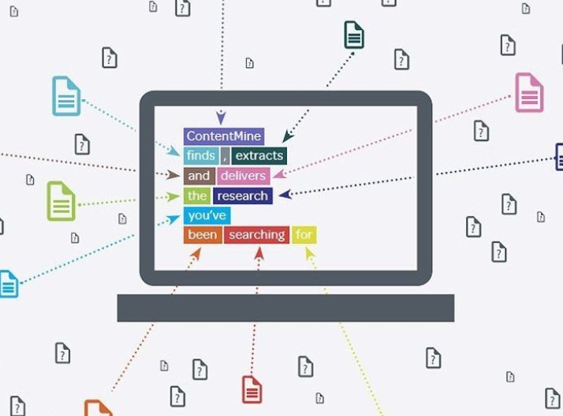
Human resources slide 5
Business Objectives
Information Retrieval
Information Extraction
Data Mining
Our vision and goal to improve the business goals targets both customers and recruiters
To improve the listing of search results and the text architecture.
Giving specific titles to each job posting based on the description of the job.
To redirect the user to the desirable job link details via the apt job listing title.

Slide 5
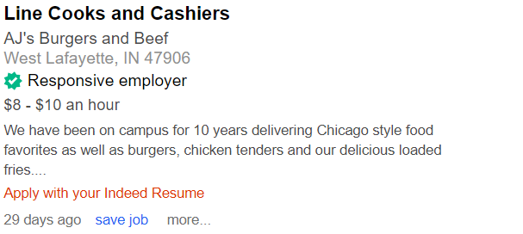


Human resources slide 8
Data Analysis
Data collection is done from Indeed.com and Craigslist.com
Scrapped the data using Beautiful Soup and URLlib.
Training data of 1035 job listings from Indeed.com
Filtered the duplicate job postings from 1035 to 674 jobs.
Processed the job listings and labeled them with 293 unique titles (classes).
Train and Test data divided on split of 70%.
Tokenization, Lemmatization, Stop words and punctuation removals
Uni, bi and tri grams taken into consideration.
Data from Indeed

Slide 6

Human resources slide 8
Data Analysis
Models Applied:
Naïve Bayes
Logistic Regression
Random Forest
Support Vector Machine
Support Vector Machine
Regularization parameter which avoided overfitting on train data.
SVM runs faster than the Random Forest.
Gives better validation results on manually validating the test data.
Gives highest accuracy.
Models Selected:

Slide 7

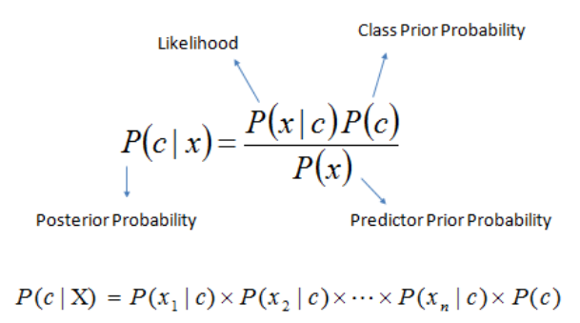
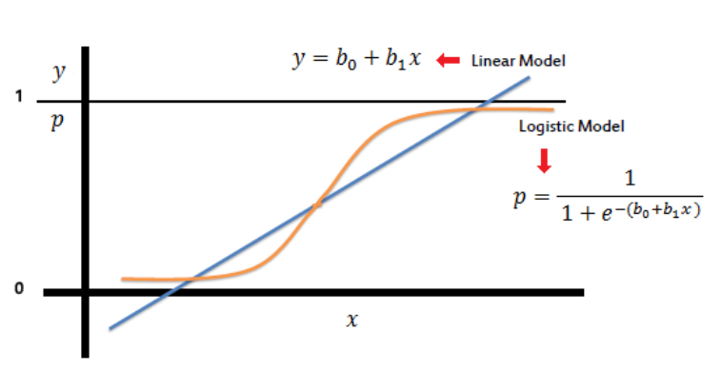
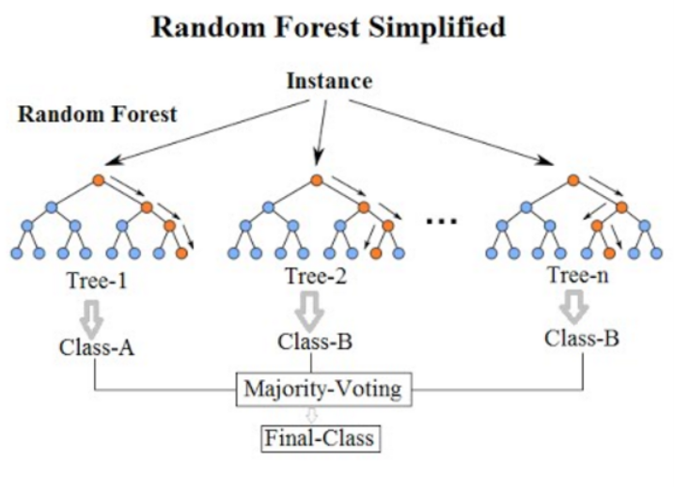
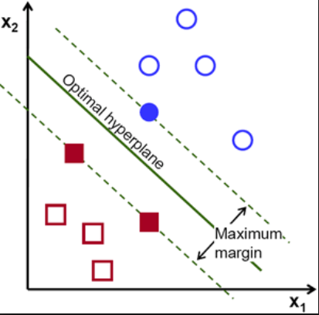
Human resources slide 7
Machine Learning Models Accuracies
2.97%
10.97%
17.74%
20.29%
Naive Bayes
Logistic Regression
Random Forest
Support Vector Machine

Slide 8
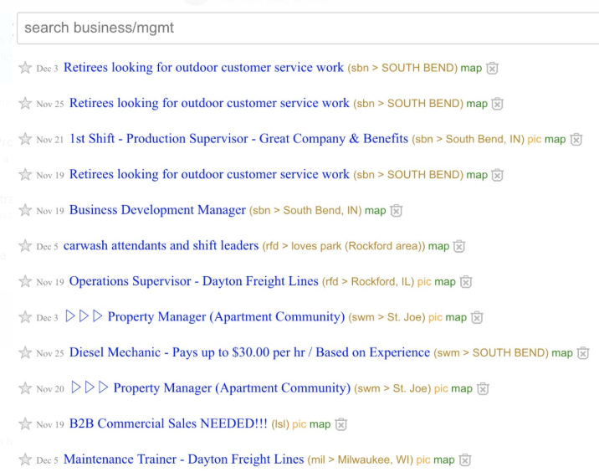
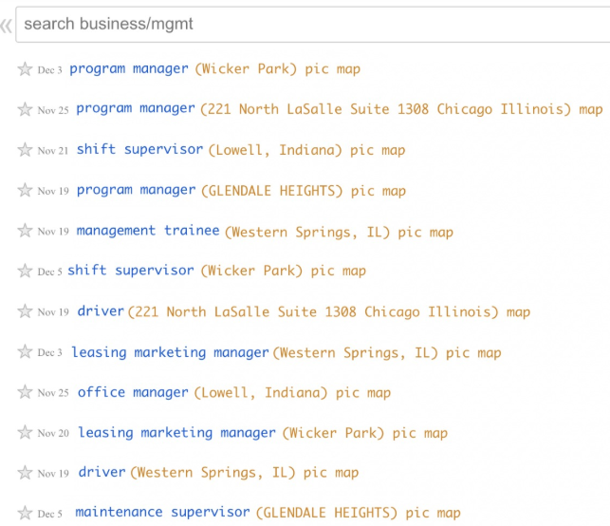
Machine Learning Models Validation

Slide 9
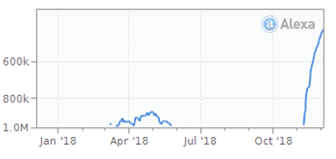
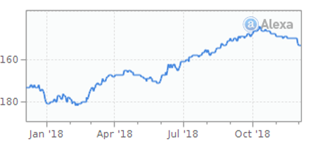
Slide 10
Data Driven Goals
Present ranking of craigslist
(Source: alexa.com)
What we expect in future after our services
(Source: alexa.com)

Slide 10
Human resources slide 4
Future Scope of Improvement
Employment Type:
Compensation Range:
What specifics are companies looking for
A person always wants to know the sallery range
Name Of Organization:
Brief and Relevant Information:
A person always wanyo see the name of company
A person always wants a title to be succint and accurate about the job
CUSTOMER

Slide 11
Recommendations
Craigslist can attract more users by having proper presentation of the job postings.
The value can be increased both for the users as well as the recruiters by conveying information in a well structured manner.
We can introduce filters on various additional features we get and make it more user friendly.

Slide 12
Thank You!

